Slide 1

Strategic planning
Leigh Tenkku Lepper, PhD, MPH
FASD United Affiliate NETWORK 2022

Slide 2
What is Strategic Planning?
Strategic planning is an organization's process of defining its strategy, or direction, and making decisions on allocating its resources to pursue this strategy.

Slide 3
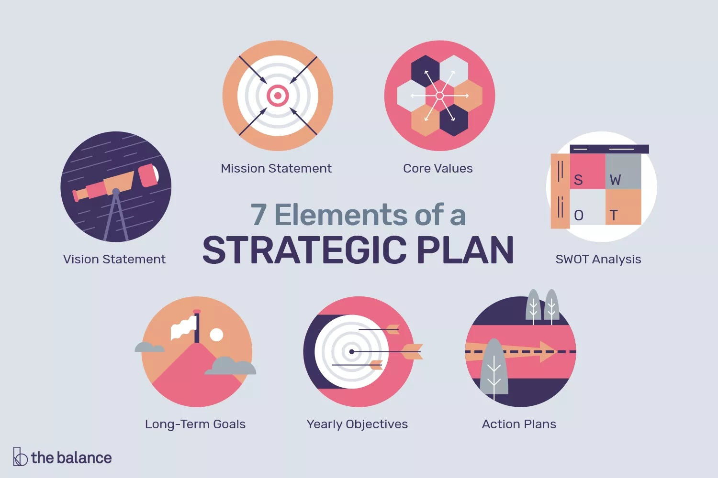

Slide 4
Vision Statement
A vision statement describes the way you envision your organization. As such, it should communicate that dream to your team members and people that you serve in an inspirational manner.
https://www.thebalancecareers.com/strategic-plan-elements-2276139

Slide 5
Mission Statement
While a vision describes how you view your organization to you’re the people you serve and other stakeholders, a mission statement describes what you do currently. It often describes what you do, for who, and how. Focusing on your mission each day should enable you to reach your vision. A mission statement could broaden your choices, and/or narrow them.

Slide 6
Core Values
Core values describe your beliefs and behaviors. They are the beliefs you have that will enable you to achieve your vision and mission.

Slide 7
SWOT Analysis
SWOT is an acronym for strengths, weaknesses, opportunities, and threats. A SWOT analysis provides your organization position in the market. It allows you to spot and name the important aspects, happenings, and adversaries of your organization.

Slide 8
Long-Term Goals
Long-term goals are statements that drill down a level below the vision and describe how you plan to achieve it. This set of goals usually starts 2-3 years out and extends to around 3-5 years into the future, directly aligning with your mission and vision statements.

Slide 9
Yearly Objectives
Each long-term goal should have a few one-year objectives that advance your goals. Each objective should be articulated as SMART as possible: Specific, Measurable, Achievable, Realistic, and Time-based.

Slide 10
Action Plans
Each objective should have a plan that details how it will be achieved. The amount of detail depends on the amount of flexibility you want your team to have. The more detail that is provided the less flexibility exists for those that follow the plan.

Slide 11
When do you need to do strategic planning?
When you initiate a new organization
Revise your strategic plan every 2-4 years
When you hit a state of apathy among your members
When you have a change in leadership

Slide 12
WHO GETS INVITED?
All Board Members or Committee members
All Key Players actively involved in your affiliate organization

Slide 13
FORMAT
ONE all-day event
TWO half-day events
THREE-FOUR evening meetings for 2 hours each
Basically whatever works best for your organization

Slide 14
Strategic plan process
This process is one I have used with many organizations

Slide 15
A TYPICAL ONE-DAY STRATEGIC PLANNING MEETING
9:30 Coffee, informal meeting
10:00 formal introductions and outline for the day
10:15 structure of [NAME OF YOUR ORGANIZATION]-who does what?
10:30 future gazing-what do you want to see happen in three years?
11:00 brainstorming
12:30 Break for Lunch
1:00 rethinking ideas
2:00 how to make it happen - subcommittees
2:30 getting it on paper

Slide 16
BRAINSTORM PROCESS
Your group will have lots of IDEAS. Anything goes (within reason--☺).
Get them all down on paper – USE flip charts with sticky backing—POST on the walls
USE a prioritization process to narrow down what you want to work on first
Delphi technique—everyone votes on a piece of paper and identifies their TOP 3 choices with the numbers 1, 2, and 3. These are collected and the numbers are posted on the BIG list of ideas.

Slide 17
What does a strategic plan look like?

Slide 19
FINAL THOUGHTS
Should start with some ground rules that everyone agrees upon.
Members need to commit to the process
Every voice needs to be heard—even the shy/quiet voices
Need to have a strong facilitator—gotta keep things moving along and gotta make sure no one dominates the conversations.

Slide 20
Real-Life Example
NOFAS Missouri is disbanding due to no one who is willing to take over the leadership.
Have been working with Kansas as they have been creating their new affiliate organization which has now been made official.
The two groups are now in discussion to come up with plans to create a bi-state affiliate organization.
Kansas FASD Support Network already has a clear set of very viable objectives in their strategic plan.
NOFAS MO has reviewed their mission and objectives and are totally on board with them.
Next….the KS leadership will meet with their Board and confirm that they are all in favor of and support of the merger of the two groups.
Once that has received the thumbs up….then we step in strategic planning for the combined group and will most likely change the name to something that fits a two-state affiliate organization.

Slide 21

Questions and Comments??
Contact information:
Leigh Tenkku Lepper
tenkku@gmail.com
573-301-1128

